Slide 1
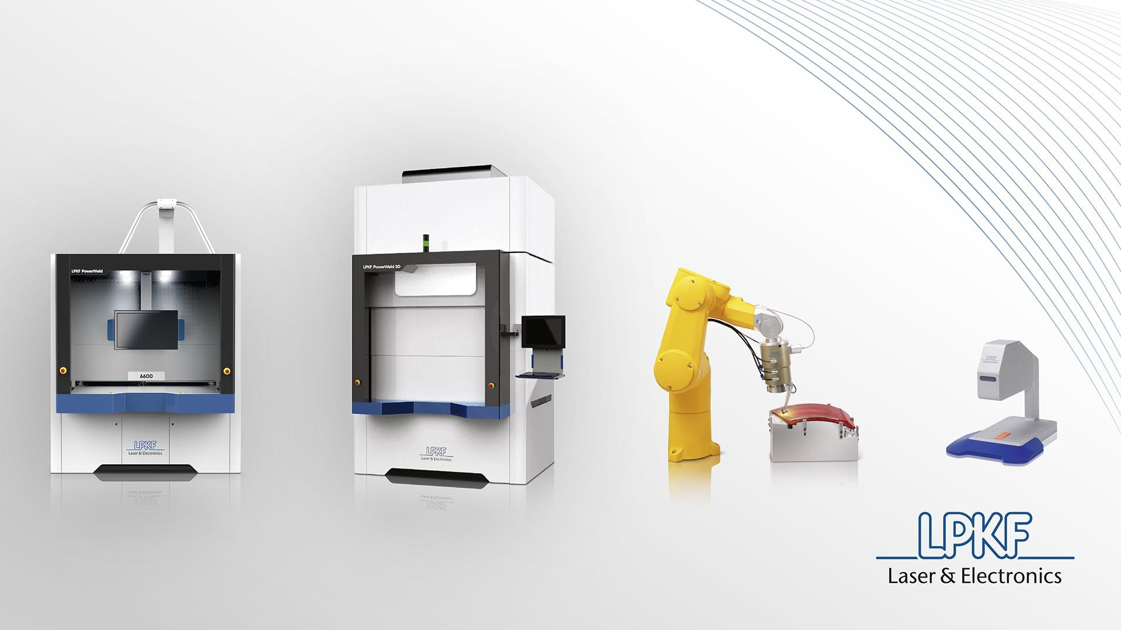
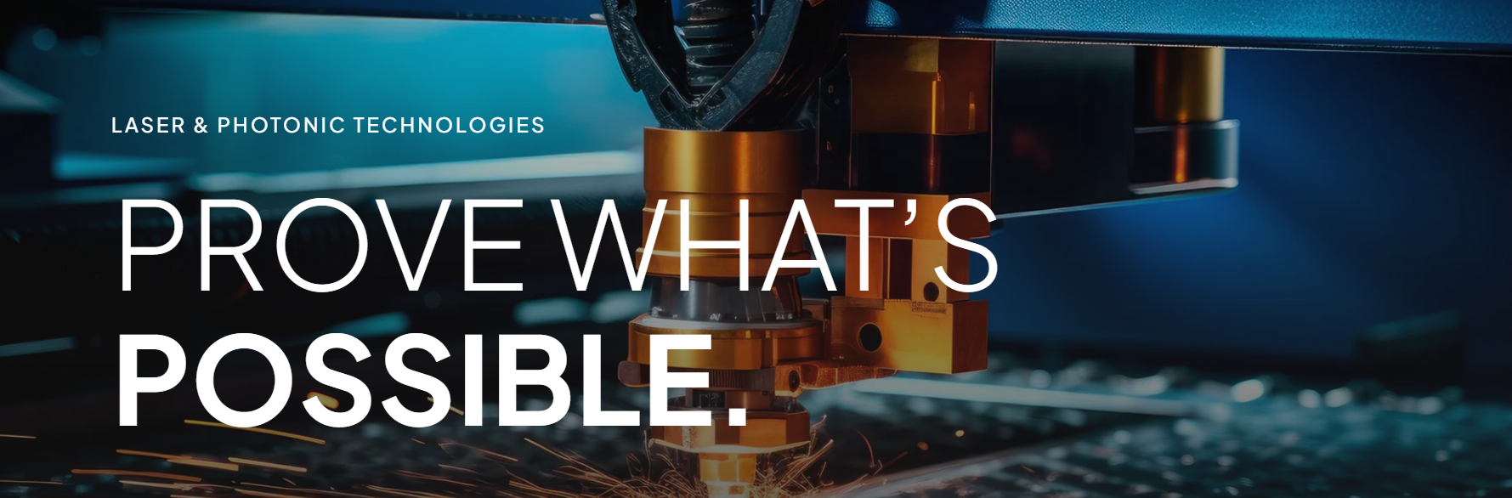

LPKF Laser & Electronics and Optical Engines, Inc. Present:
Exploring 2 Micron Laser Plastic Welding Technology

Slide 2

Why the Webinar?
To inform and educate about various Laser Plastic Welding technologies
“Clear” up any ambiguities and help answer questions surrounding the technology
Focus on the specifics of clear to clear, “2 micron” laser plastic welding
Advance the field of Laser Plastic Welding in general!
Provide expert advice so engineers can begin to design and implement 2 micron bonding technology

Slide 3
Personal and Company Bios
Your host:
Dax Hamilton
14 years Laser Plastic Welding, I have seen and worked on many 100’s of applications
Formally Trained Machinist both Manual and CNC
Mechanical Engineer with experience in all aspects of machine design
In-depth experience with lasers and optics
Have worked with most of the LPW equipment suppliers in some capacity over the years!
LPKF Laser & Electronics
Webinar Host
Best known global supplier of Laser Plastic Welding equipment
Worlds first supplier to “mass” commercialize Laser Plastic Welding
First to investigate 2 micron technology over 13 years ago
Holistic provider of Laser Plastic Welding expertise
Optical Engines, Inc.
Sponsor
Combined 100+ years in complex laser and fiber processing expertise
Pioneer of the high-power, air-cooled laser engines
Worlds only “all-in-one” laser engine – diodes, power supply, driver and safety all in one box
Renowned experts in glass and fiber processing + beam manipulation technology
Only supplier of top-hat shaped 2 micron laser and 1 micron fiber laser

Slide 4
Webinar Agenda
Introduction to Laser Plastic Welding
Key Differences from Through Transmission Laser Welding
Typical Applications
Commonly Welded Materials
Laser Sources and Optics
Design Criteria
The 3 Pillars
Nuances
Special Research
Summary

Slide 5
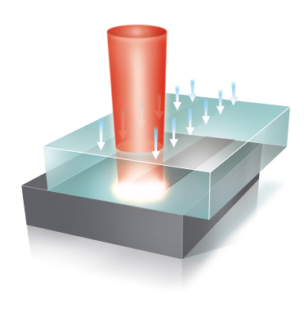
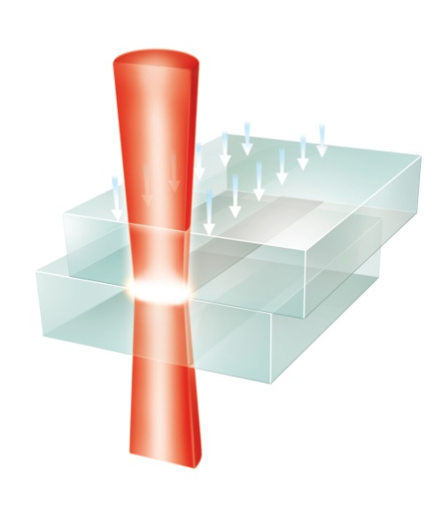
Introduction – Laser Plastic Welding
Particulate Free
No Damage to Internal Components
Precision
Laser Plastic Welding
No Mechanical Stress/ Vibration
Leak Tight (lP67)
Less Weld Flash
Highest Bonding Strength
Reduced TCO
Laser Plastic Welding is a well-known bonding technology that enables joining of thermoplastics with high precision, cleanliness, and a minimized heat affected zone.

Slide 6
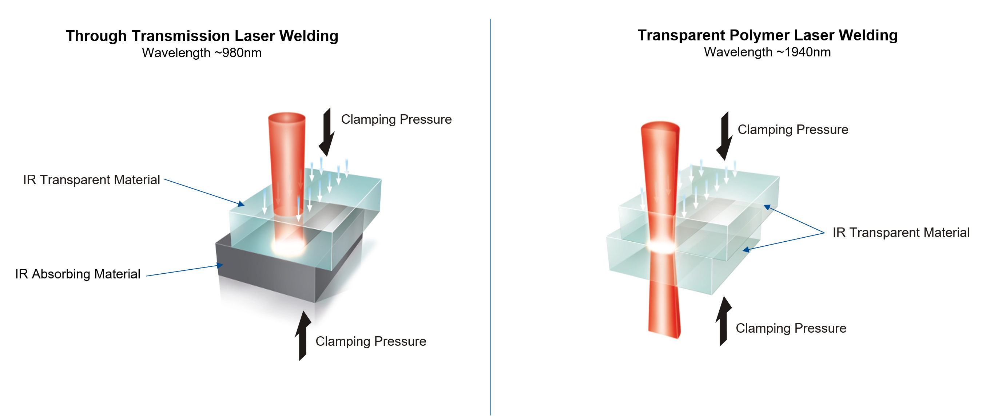
TTLW vs. TPLW Explained
Two types of Laser Plastic Welding:
Through Transmission Laser Welding, (TTLW) and Transparent Polymer Laser Welding, (TPLW)

Slide 7
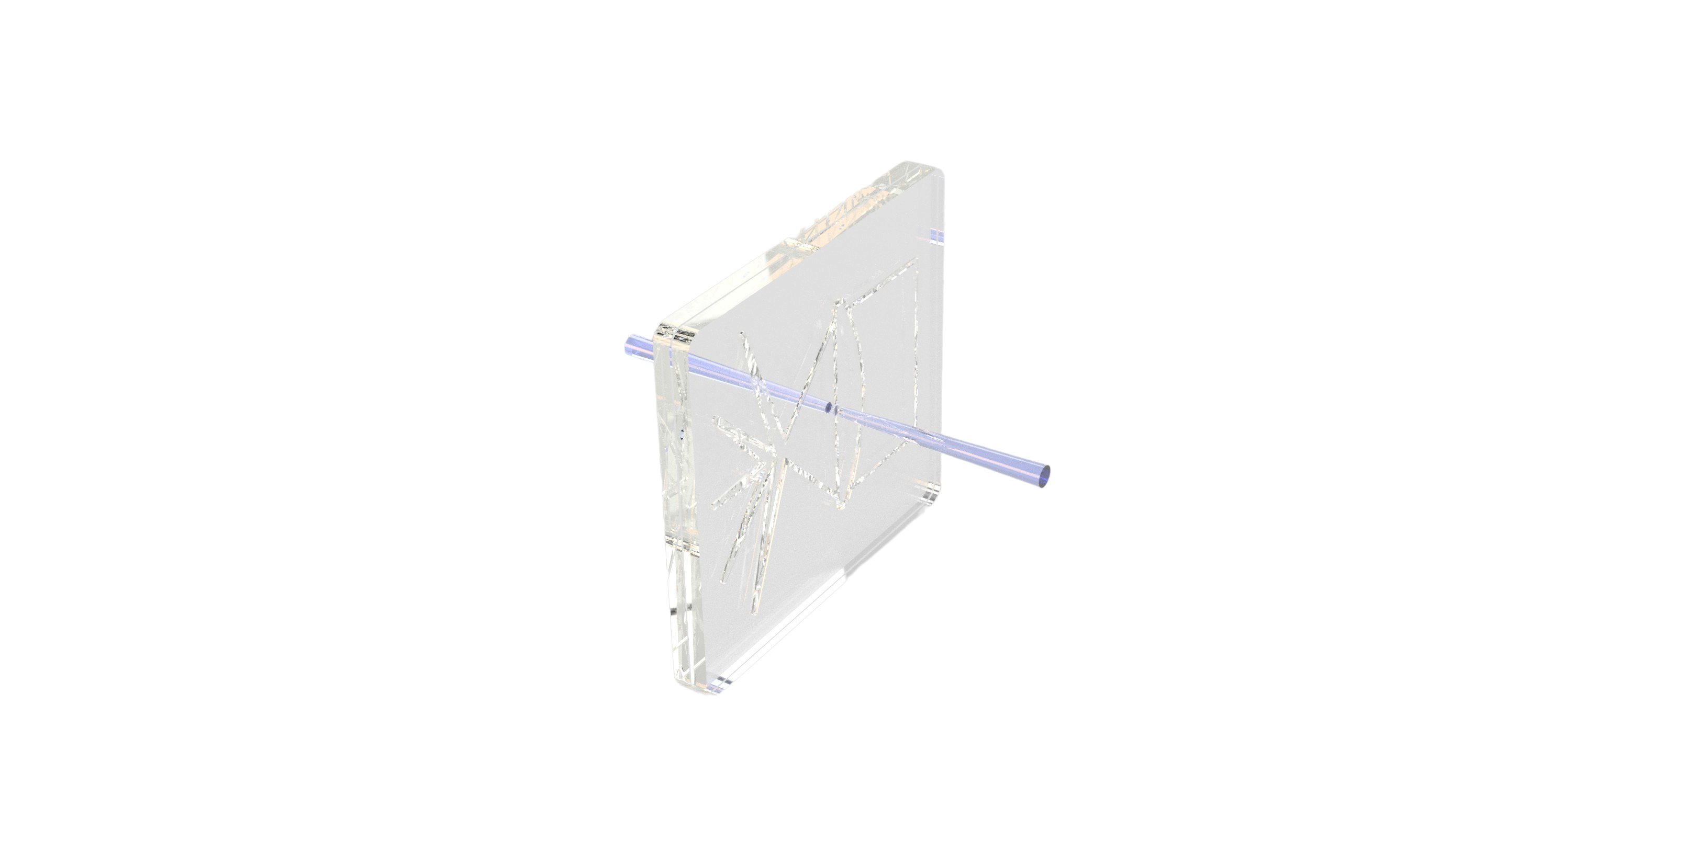
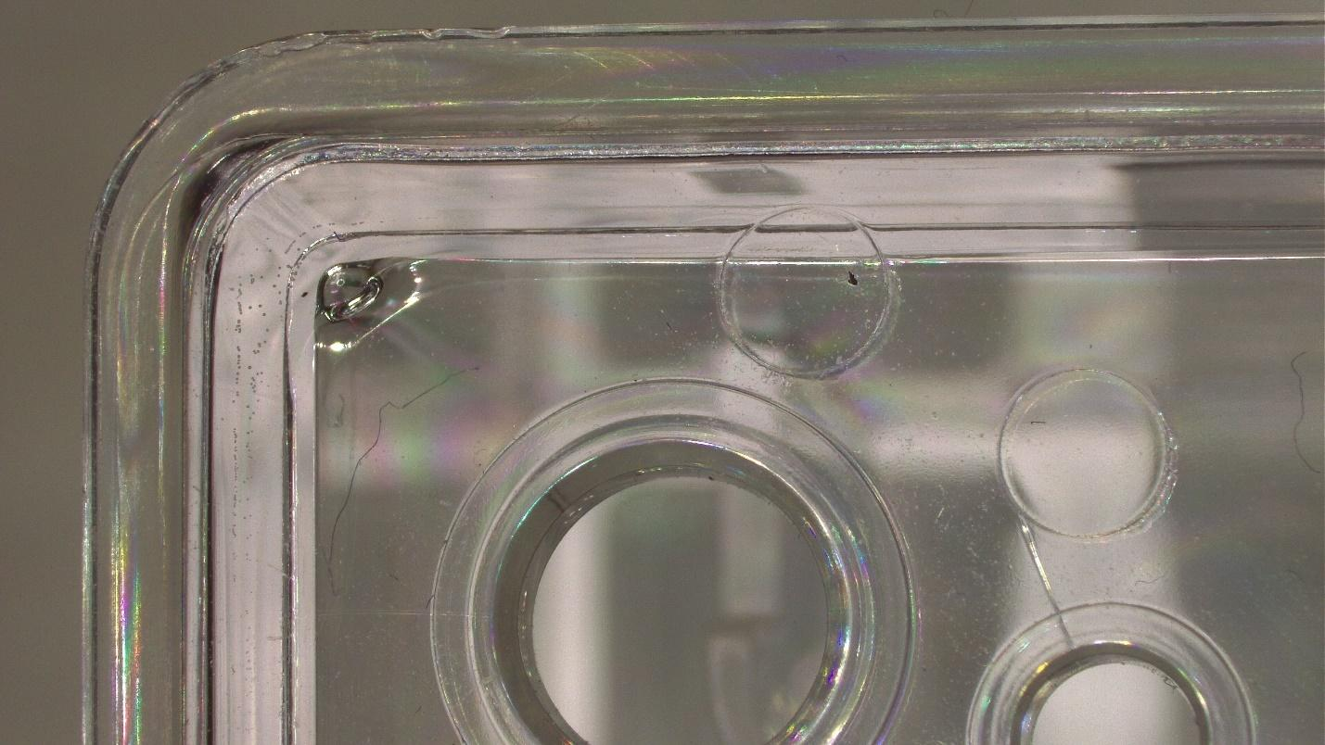
Introduction to TPLW
Many terms have been tossed around in the last 10+ years with regards to 2 micron or clear to clear laser plastic welding… It will now be called, “TPLW”, or “Transparent Polymer Laser Welding”
TPLW is particularly important for bonding applications requiring optically clear plastics without additives, such as medical devices.
Using TPLW eliminates the need for additives in the plastic that could affect bio-compatibility
Certain microfluidic and diagnostic devices rely on translucent or optically transparent plastics to be able to analyze the various fluids, etc. inside the device
While TPLW has its “nuances” such as volumetric absorption, modified welding speeds, etc., it still fills a need in laser plastic welding that typical through transmission welding processes cannot.
2µm...Transparent Polymer Laser Welding…TPLW

Slide 8
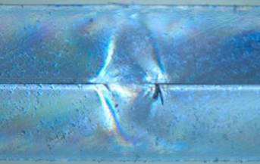
What is 2µm (TPLW) Laser Plastic Welding?
Transparent Polymer Laser Welding can be defined as: “A method of joining two IR transparent polymers by volumetric absorption of laser energy through the entire cross-section of the joining partners without the aid of absorbing additives or coatings.”
Volumetrically Affected Regions

Slide 9
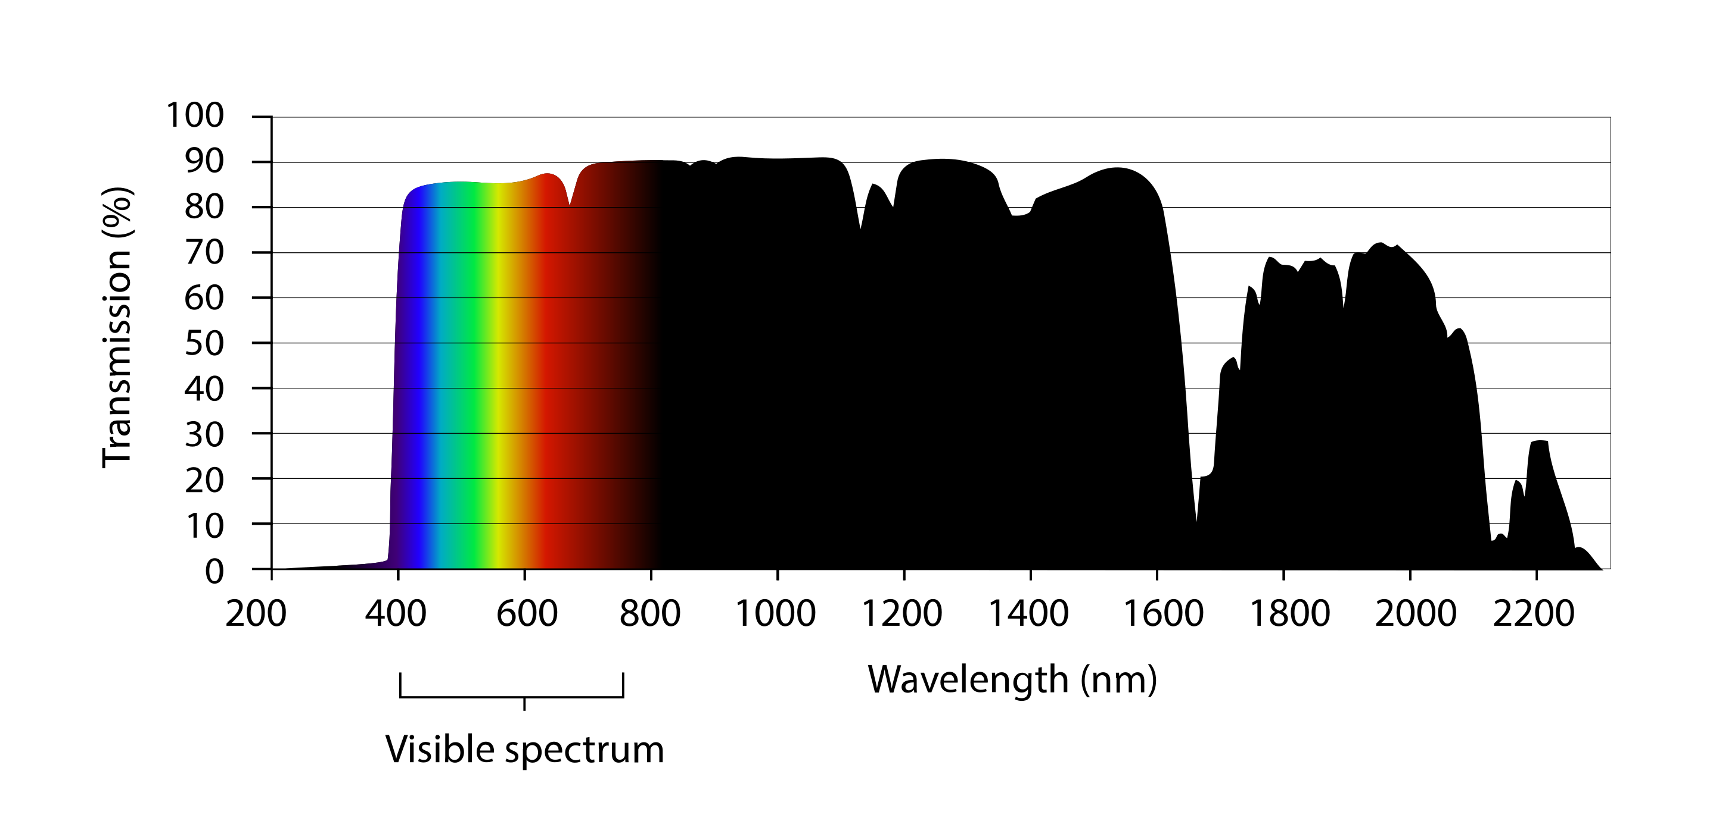
Why it Works??? - Absorption
Transmission Spectra for PMMA (Optically Clear)
~30% Absorption @ 1940nm
Graph Courtesy of Wikipedia
At wavelengths above ~1600 µm, many transparent plastics absorb volumetrically, (to a greater or lesser extent), throughout the whole beam path.

Slide 10
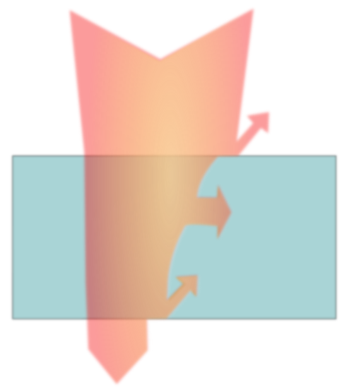










Why it Works??? – Other Optical Effects
$$\dot{q_{t}}$$
$$\dot{q_{R}}$$
3 possible modes of laser - material interaction:
$$\dot{q_{A}}\left(\text{+ }{\dot{q}}_{S}\right)$$
$A$
- Absorption
- Reflection
- Transmission
$$z$$
$$1=A+R+T$$
$R$
$$\dot{q_{R}}$$
$T$
$$\dot{q_{T}}$$
One of the reasons that TPLW works is because of a phenomenon called, “lens effect”, where the laser beam is absorbed and reflected at each interface between two materials. This effect can cause the laser beam to become more focused and intense, thereby resulting in the welding process originating at the welding plane.
A study published in the Journal of Laser Applications (JLA) in 2014 analyzed the impact of the lens effect on the laser beam intensity during welding of PC and PMMA materials. The study found that the laser beam intensity was significantly higher in the area where the two materials met, due to the lens effect caused by the refractive index difference between the two materials.

Slide 11
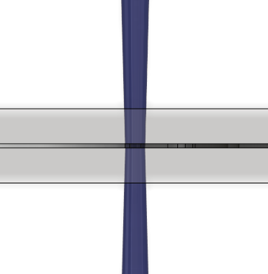


TPLW Explained
Energy absorption is volumetric and dissipated entirely through the assembly cross-section where laser energy is directed - As volumetric absorption happens, thermal expansion pushes the molten plastics “into each other” (if mechanically “fixed”) throughout the joint interface, creating a mixing and melting of the two joining partners somewhat similar to TTLW
1
2
3
4

Slide 12
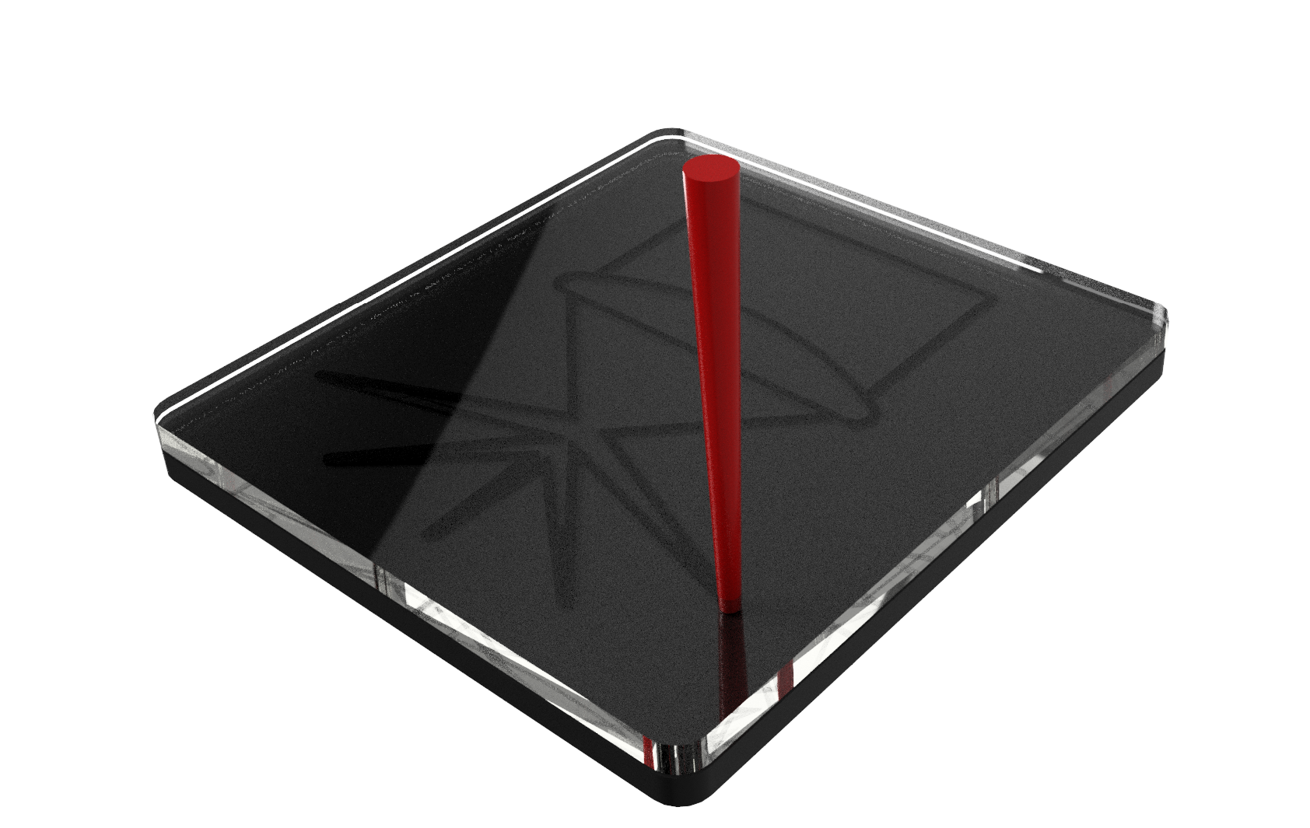
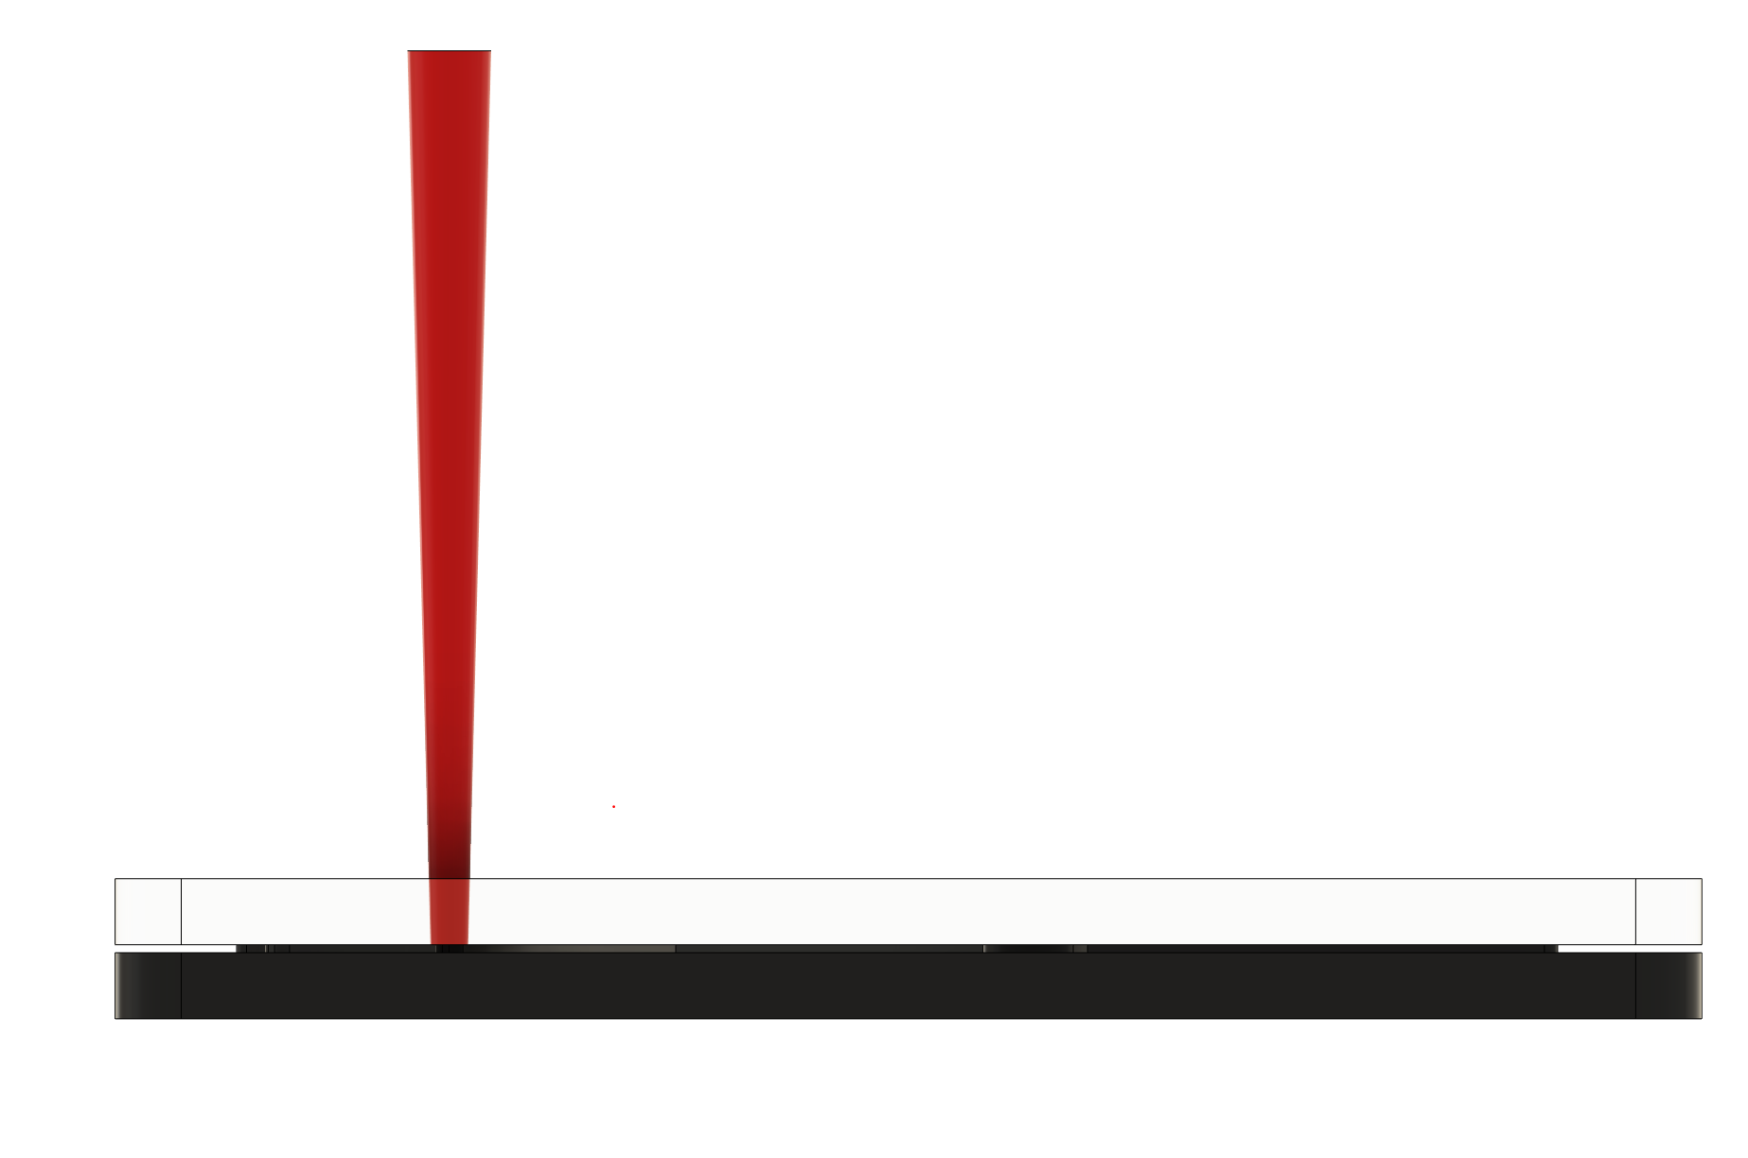
TTLW Explained
Energy absorption begins at the surface of the IR absorbing material and through heat transfer is dissipated upward into the IR transparent material and creates a mixing and melting at the joint interface

Slide 13
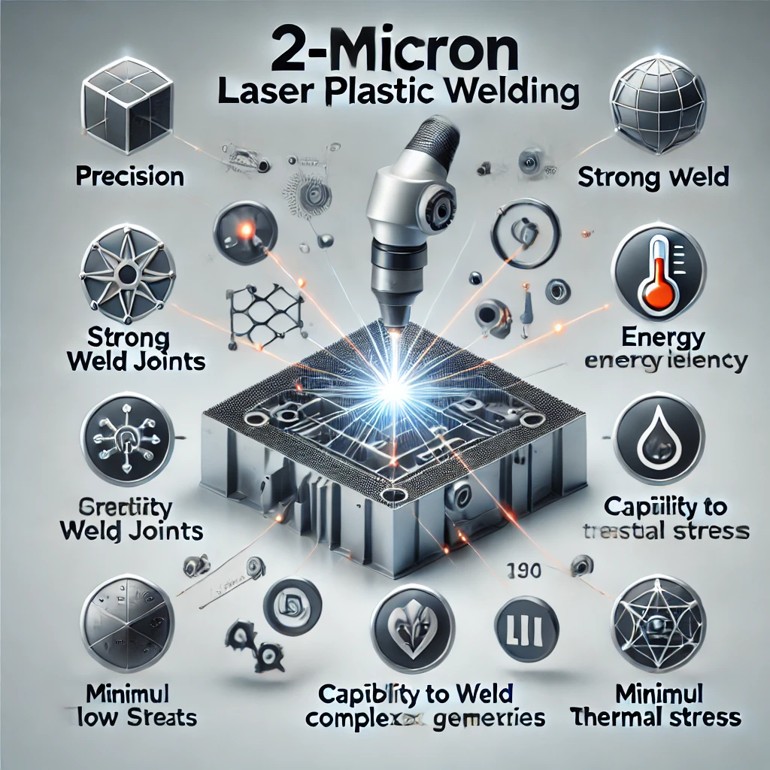
Advantages of TPLW
No Absorbing Additives
No Changes to the Polymer
Multi-Layer Welds
Deeper Welding Penetration
Difficult to Weld Polymers
Certain “Annealing” Properties
Robots are NOT taking us over as quick as I would have thought…

Slide 14
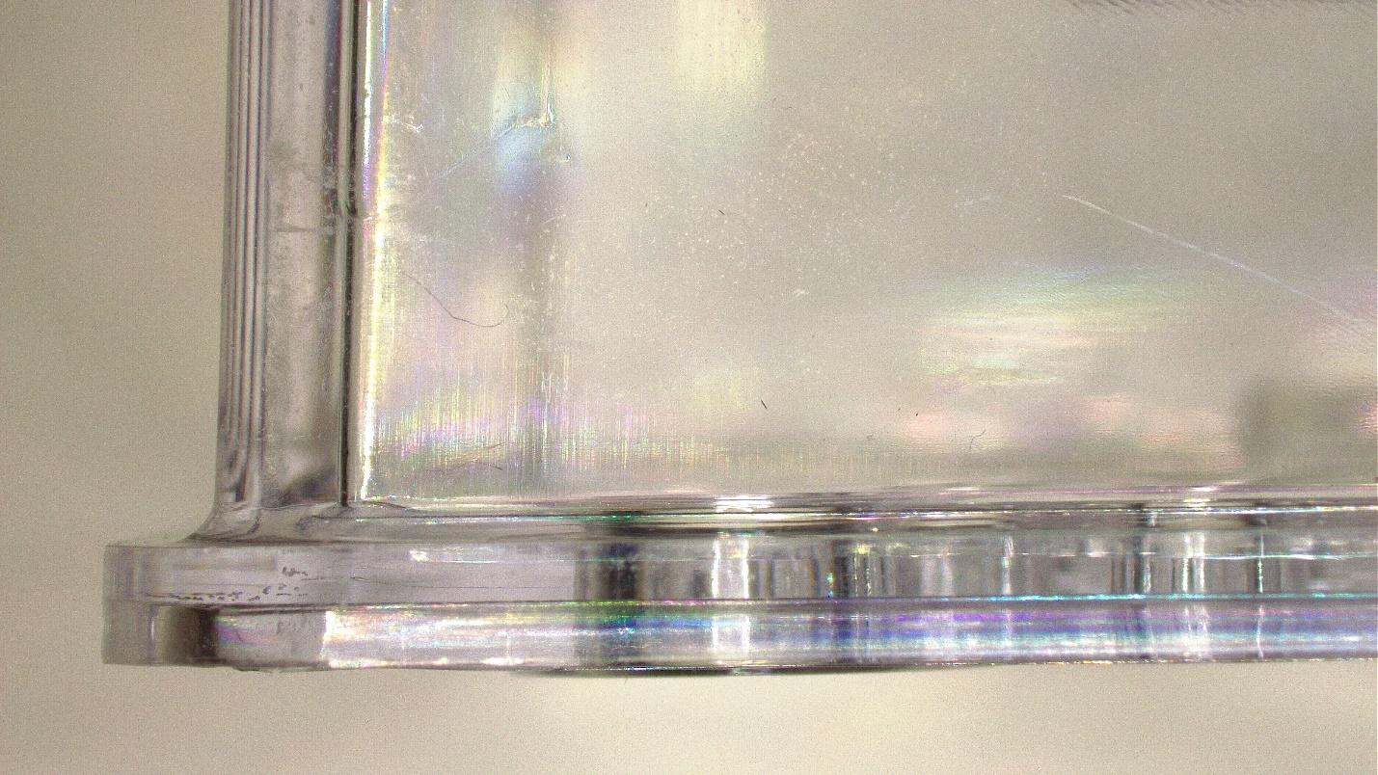
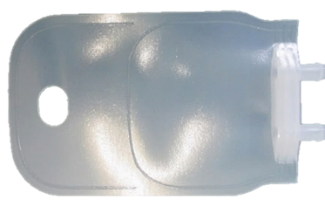
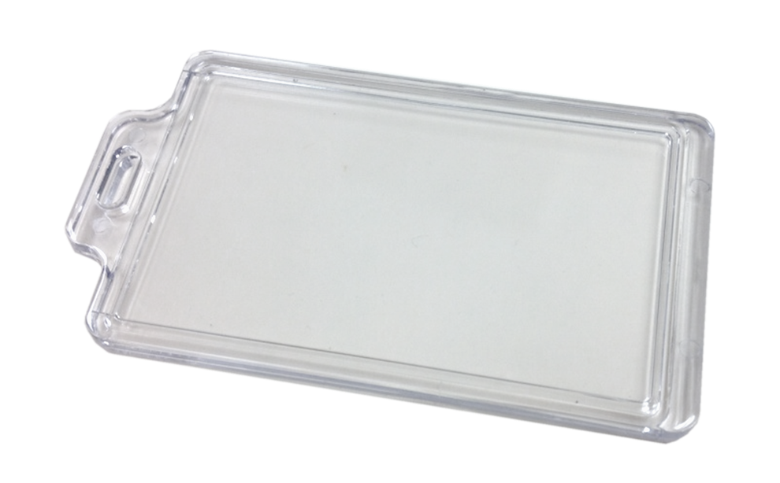
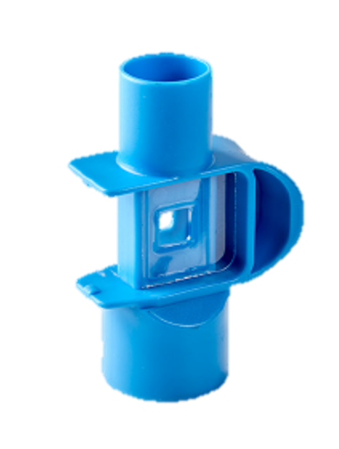
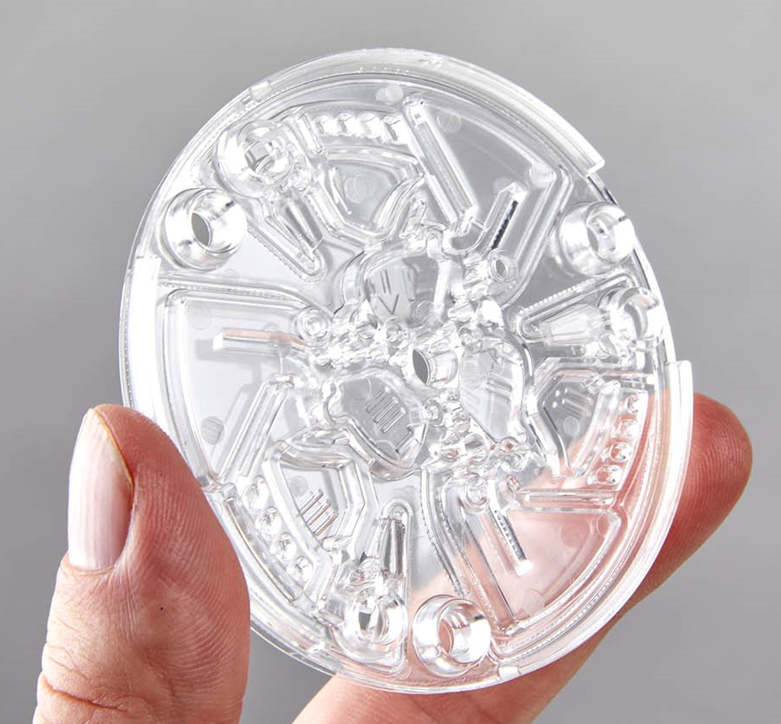
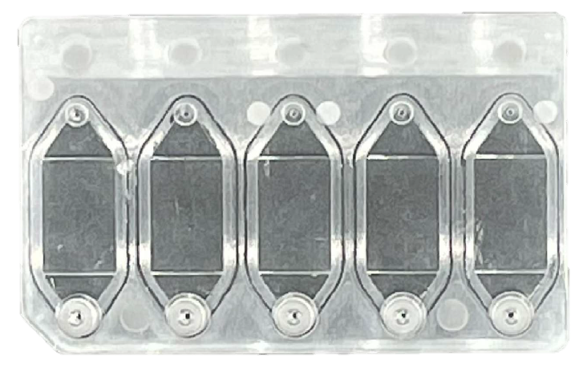
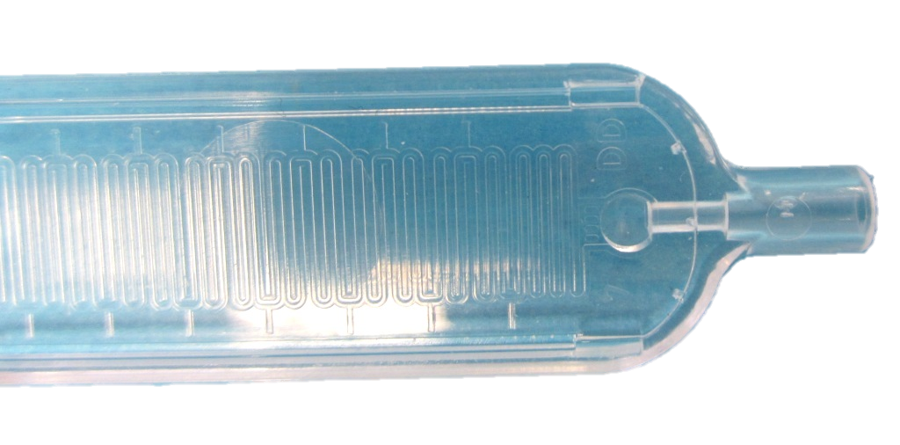
Applications
Tubing to Fitting
Microfluidic
Fluid and IV Bag
Sample Trays
Packaging

Slide 15
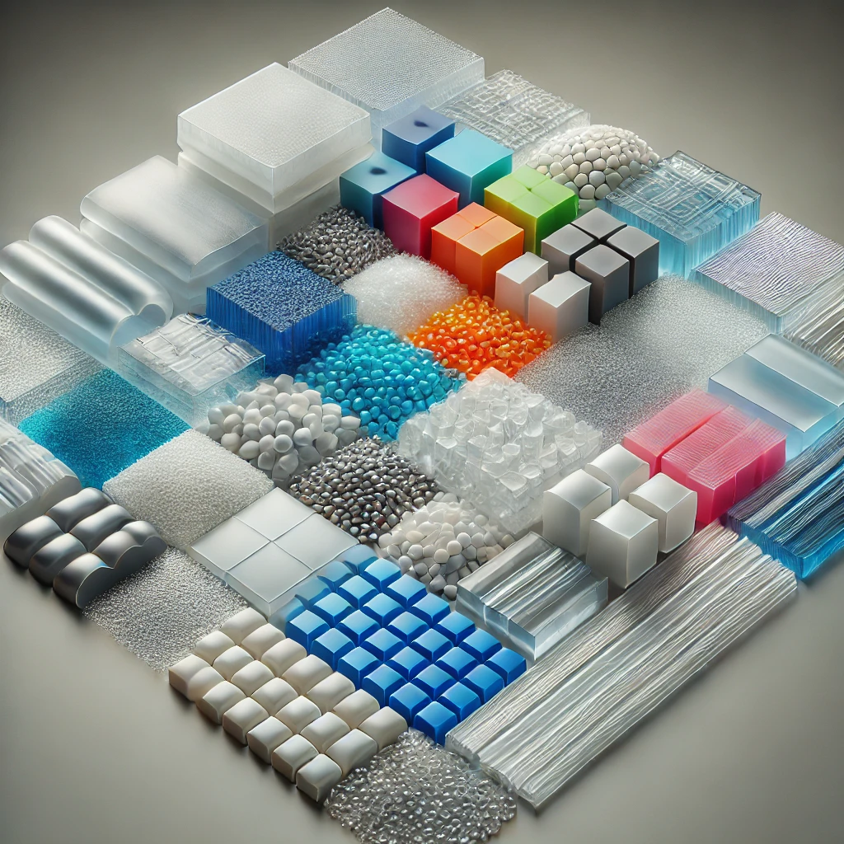
Common Materials for TPLW
PP - Polypropylene
PE - Polyethylene
TPU – Thermoplastic Polyurethane
PVC – Polyvinyl Chloride
COC – Cyclic Olefin Polymer
COP - Cyclic Olefin Copolymer
PA - Polyamide
PMMA – Polymethyl Methacrylate
PC - Polycarbonate
PET – Polyethylene Terephthalate

Slide 16

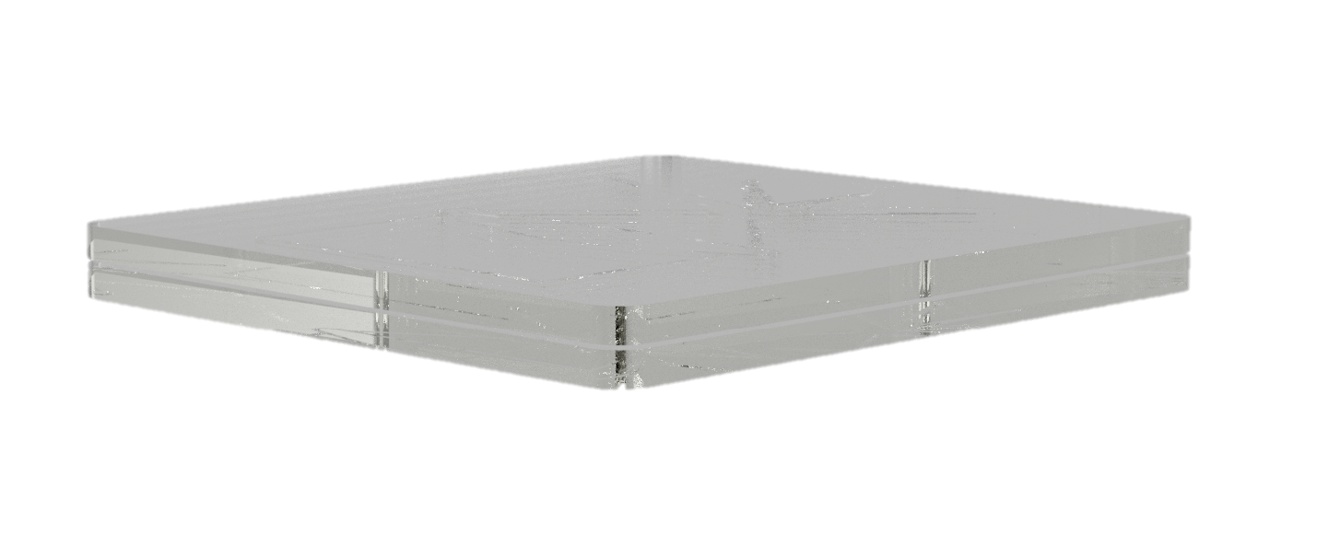
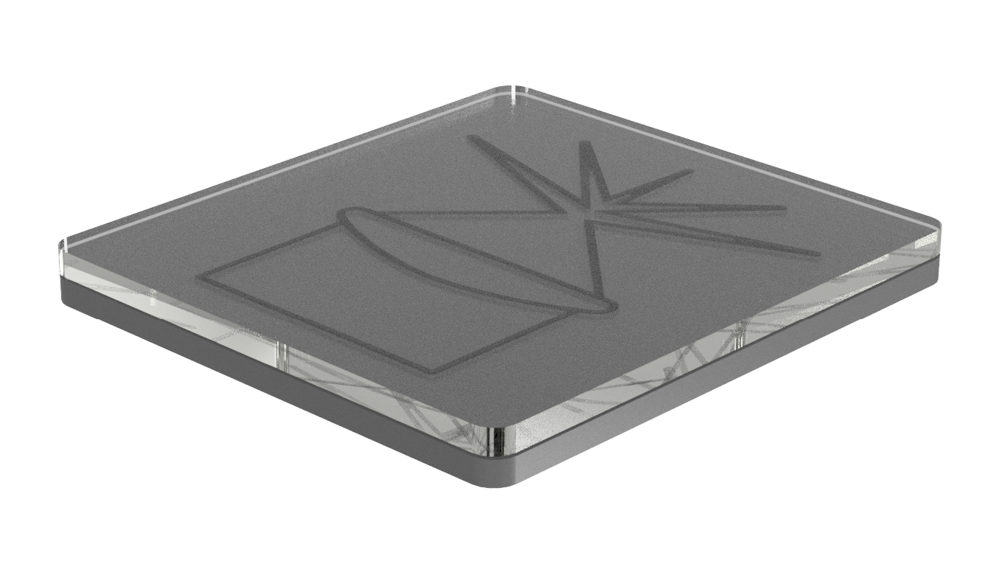
Design Criteria
No additives needed
Upper part thickness to be less than 3mm
Bottom part can be optically clear or opaque
<3mm
Clear or Opaque

Slide 17
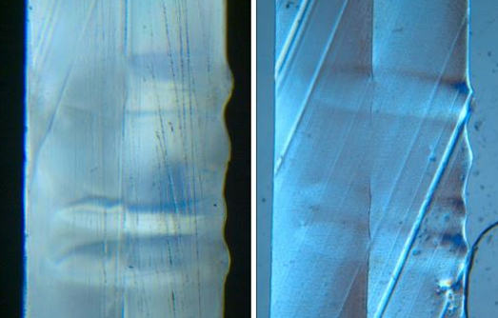
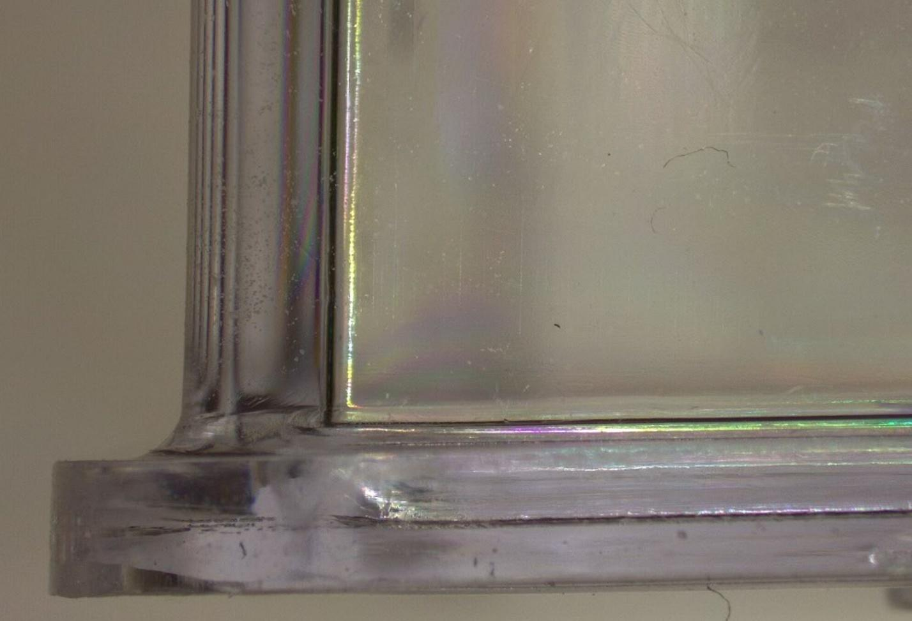
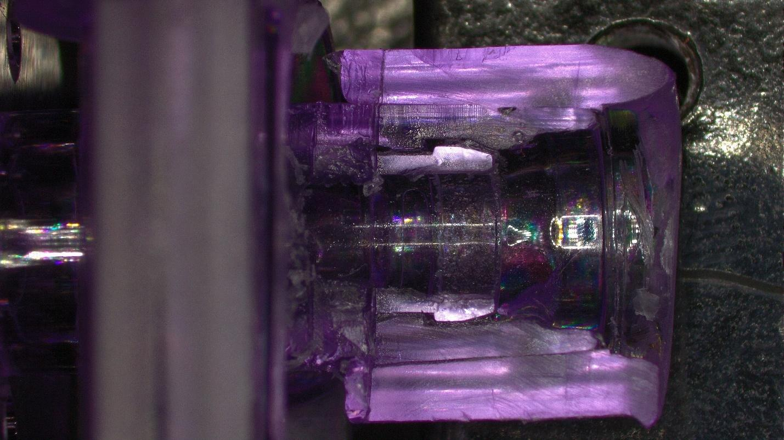
“Nuances”
Thermal Deformation
Slower Welding Process
Areas of deformation due to volumetric expansion
Speed
Speed
100mm/s – 1500mm/s
10mm/s – 100mm/s

Slide 18
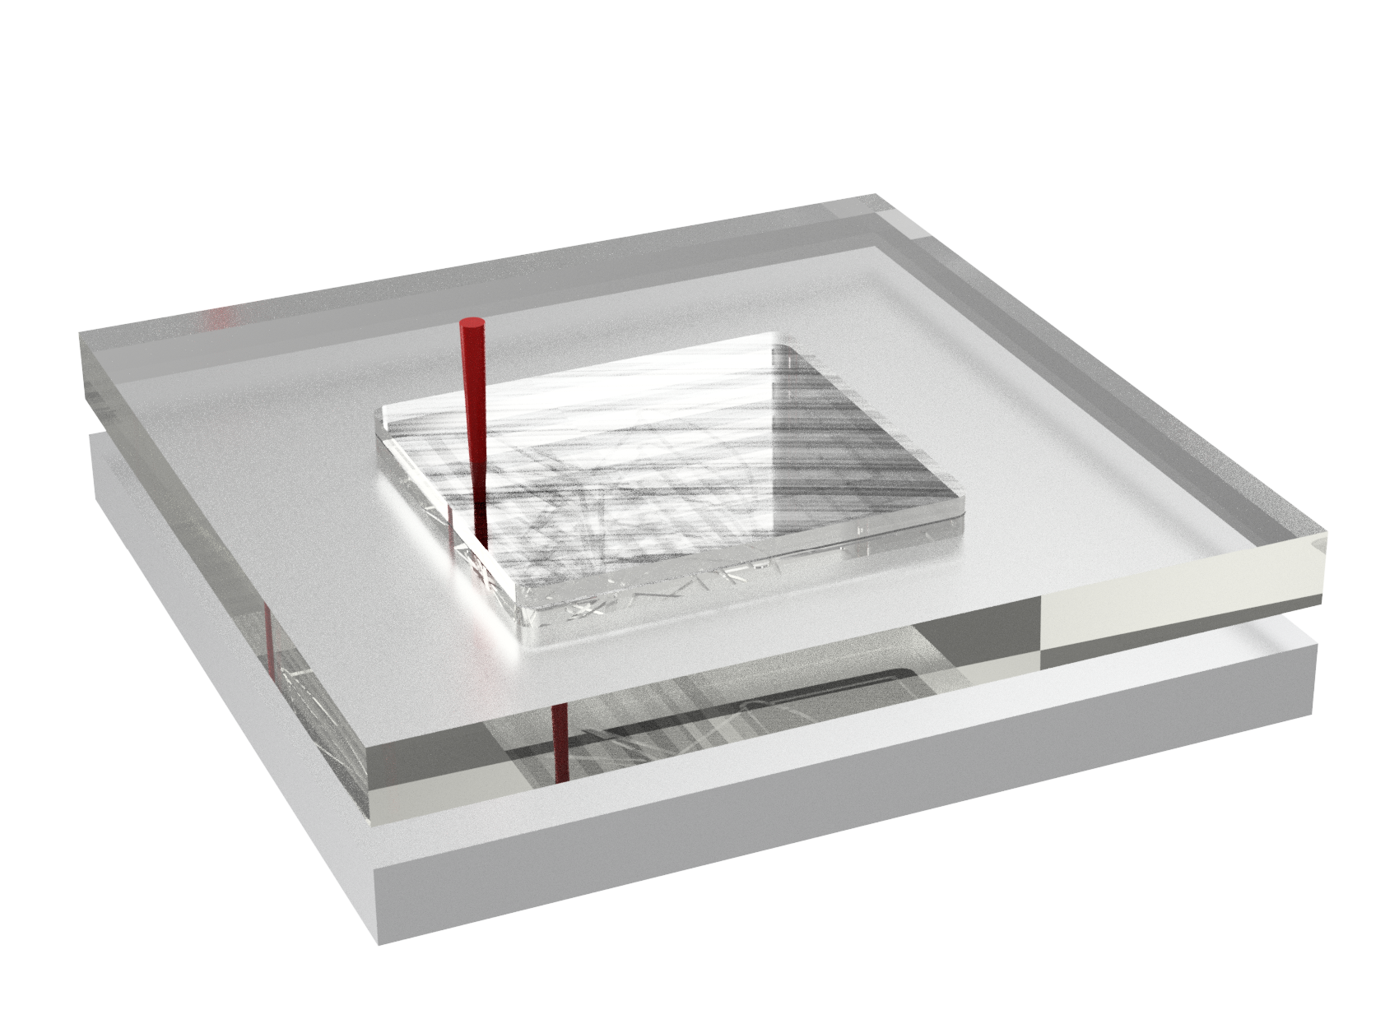
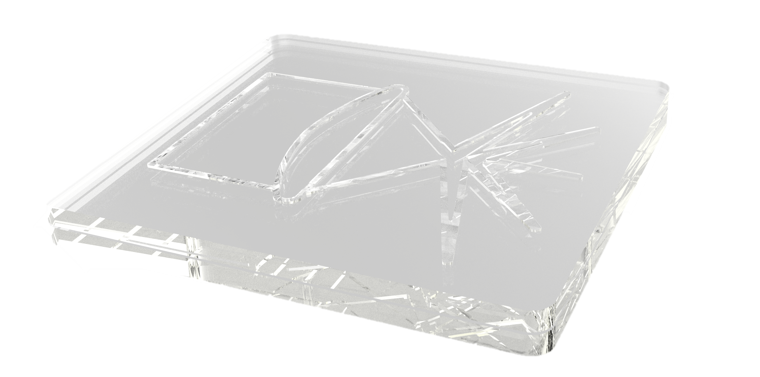
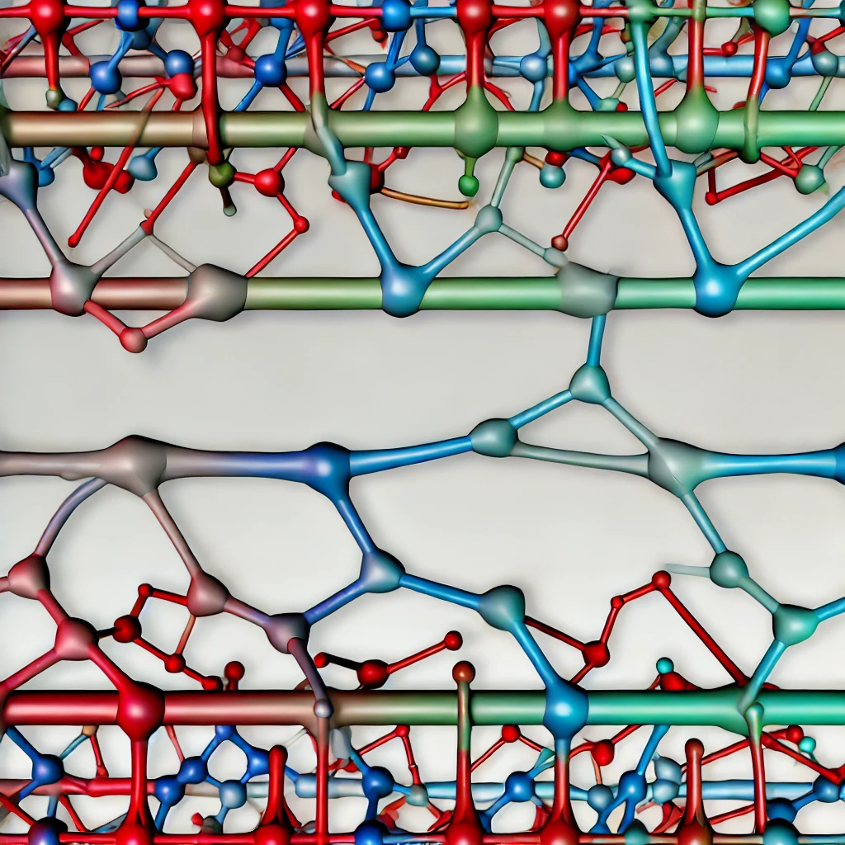

The 3 Pillars of TPLW
Transparent Upper and Lower Layer
Mechanical Contact
Compatible Materials
1
2
3

Slide 19
The 3 Pillars of TPLW – Transparent Layers
Transparent Upper and Lower Layer
The biggest difference between TTLW and TPLW is that BOTH materials are transparent to wavelengths of ~1 µm, and typically to the eye.
No laser absorbing additives or coatings need to be used.
In some cases, translucent or even opaque materials can be welded however, they must be very thin in cross-section, or the surface would tend to degrade before sufficient bonding could happen. (white to white film example)
1

Slide 20
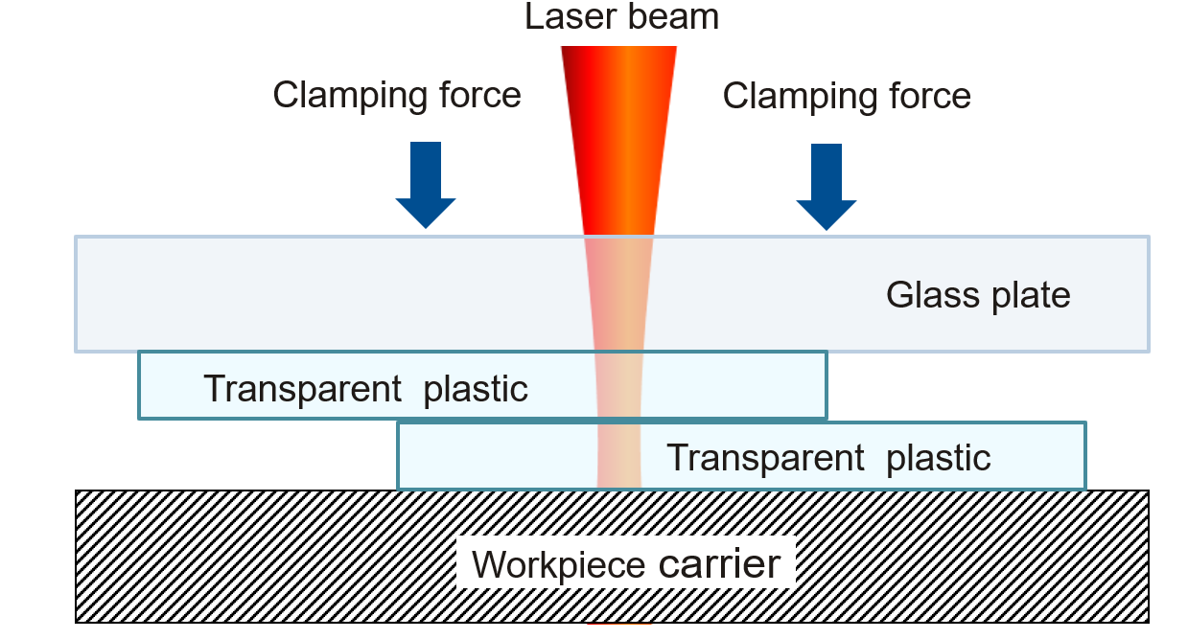
The 3 Pillars of TPLW – Mechanical Contact
Mechanical Contact
This is still true with TPLW - both methods of welding need to have mechanical contact.
There is only a slight difference with TPLW in that the two joining partners do not have to be TIGHTLY clamped together.
If there is no top clamp used, then a deformation or thermal expansion effect will happen but for the most part the two materials will still bond, and larger gaps between the two materials can be overcome (>0.25mm).
Glass Plate Clamping – Flat Parts
Laser beam
Laser Transparent
Laser Transparent
Clamping pressure
Clamping pressure
2
Interference Fit - Radial Parts

Slide 21
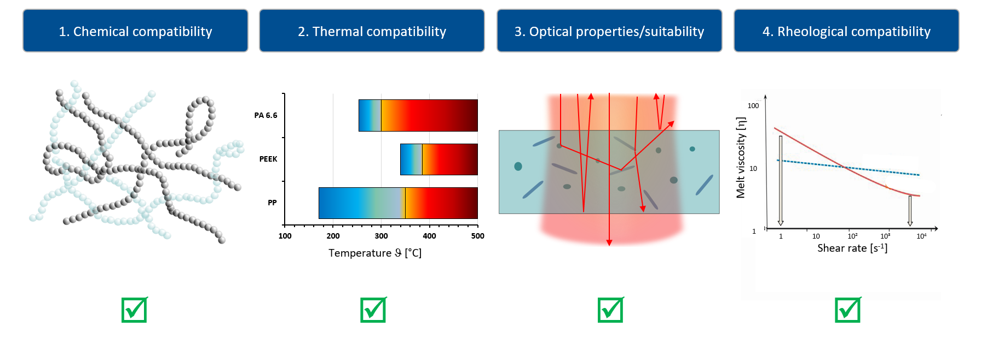
The 3 Pillars of TPLW - Compatibility
Compatible Materials
As with TTLW, the materials for TPLW also have to be compatible with each other. Both chemical compatibility and melt temperature overlap need to be met.
3

Slide 22
LASERS FOR TPLW

Slide 23
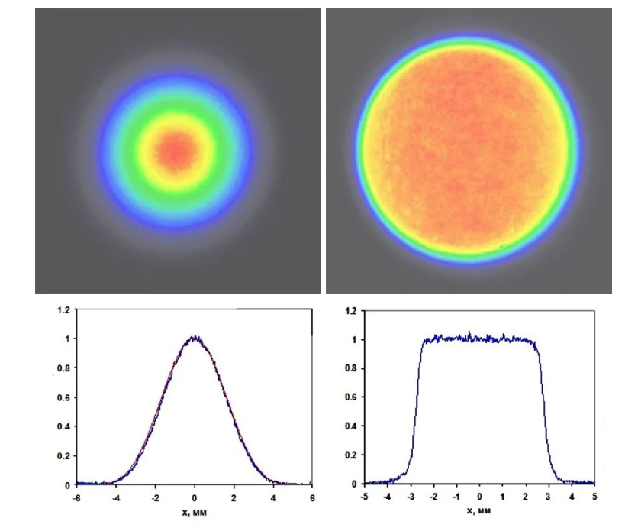
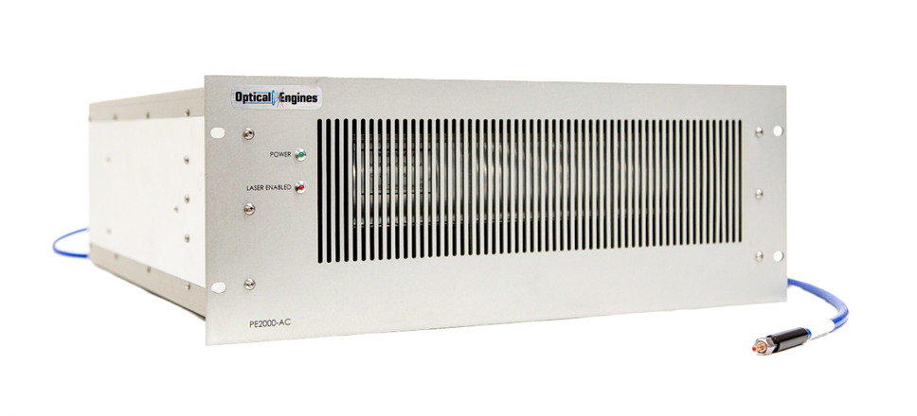
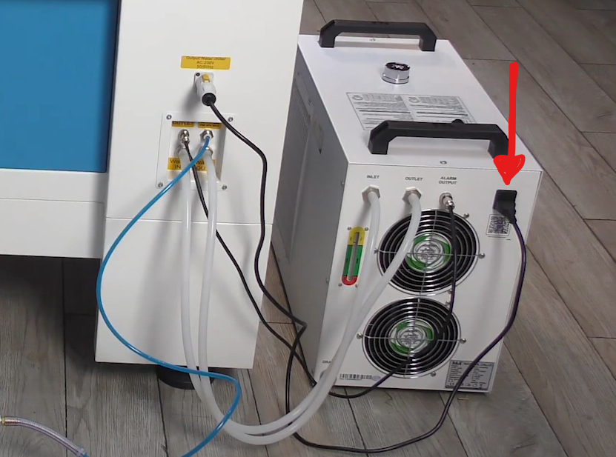
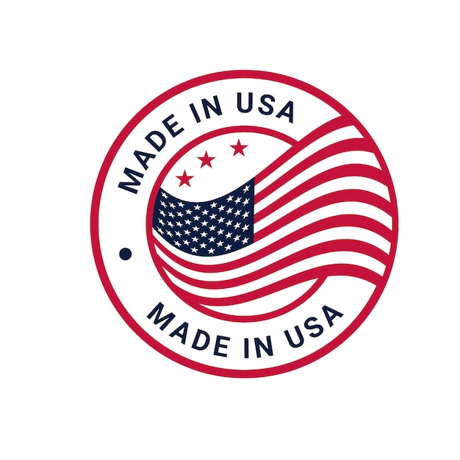
Laser Source for TPLW
“Top Hat” profile through proprietary beam shaping technology – avoids burning and other issues with gaussian beam shapes
Air cooled up to 250 Watts - Quiet (<60 dB)
No messy and unreliable chillers
4x higher efficiency over competitor’s systems
Gaussian
Top-Hat
No Messy and Unreliable Chillers!

Slide 24
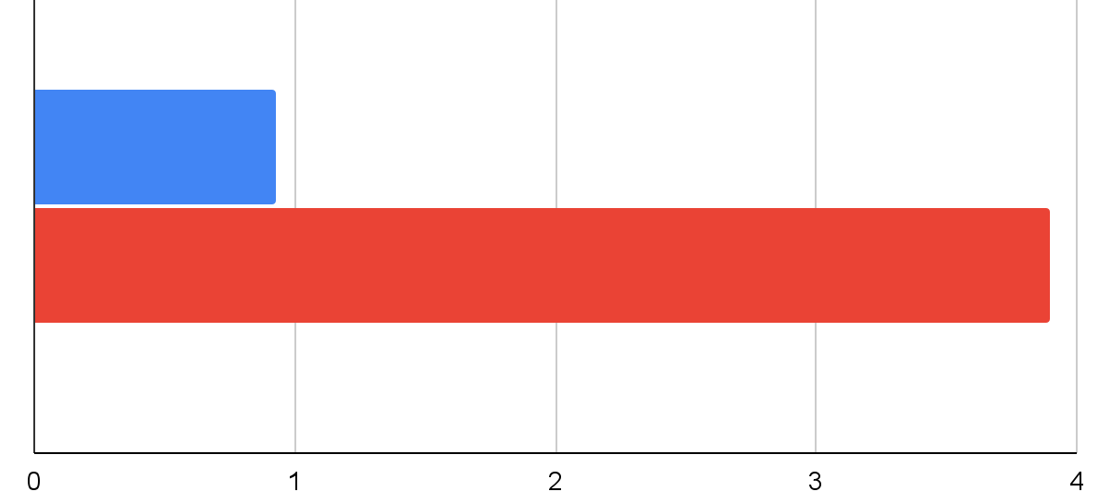
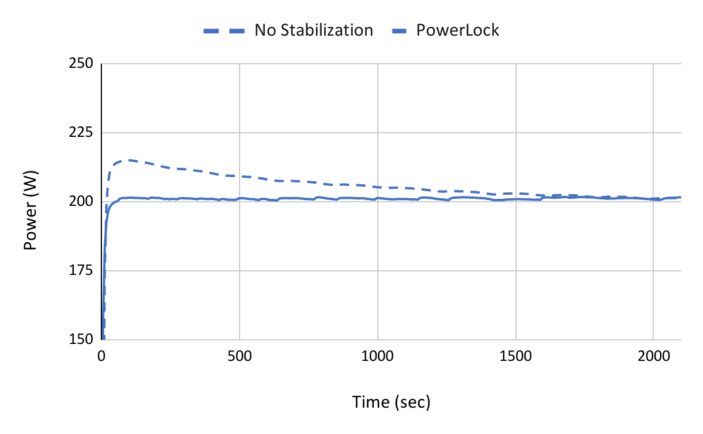
Laser Source (Cont.)
Compact (4RU 19” 50 lbs) - integrated cooling and power supply
PowerLock™ +/- 1% Stability
PowerDrive™ Control Interface
Aiming Beam
Thermal and Pyrometer Options
Direct-pump Thulium doped fiber laser architecture
Competitors use an indirect, cascade pumped architecture with an intermediate fiber laser to pump the Tm-fiber laser
lower is better
Less $ to operate
4x less power consumption
PowerLock™ +/- 1% stability
OEI
direct
pumping
Competitors
cascade-pumped intermediate fiber laser pumping
Power Consumption (kW)

Slide 25
SPECIAL RESEARCH IN TPLW

Slide 26
Special Research – Alternate Wavelengths
Transmission Spectra for PMMA (Optically Clear)
85% Absorption @ ~1660nm
93% Absorption @ ~2120nm
Graph Courtesy of Wikipedia
Alternate wavelengths in the SWIR band 1-2.5µm could be feasible for “welding” and other material processing applications

Slide 27
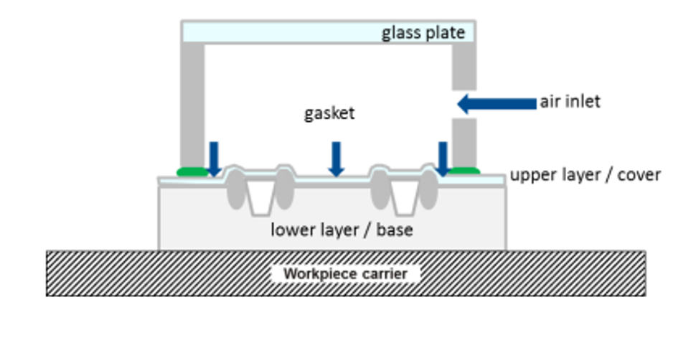
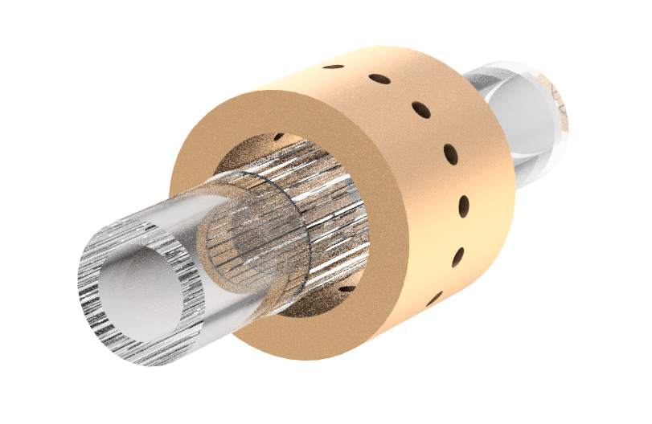
Special Research – Clamping
Differential Pressure Clamping
Air Flow “Circumferential”
Using air pressure to apply “clamping force” to the welding surface to mitigate gaps
This is… Just to get you thinking!

Slide 28
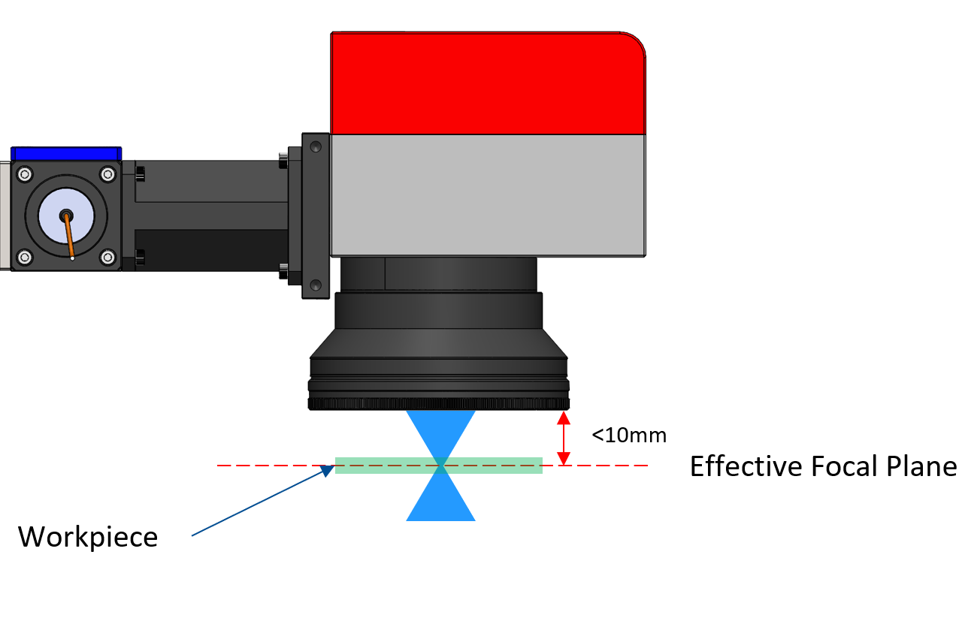
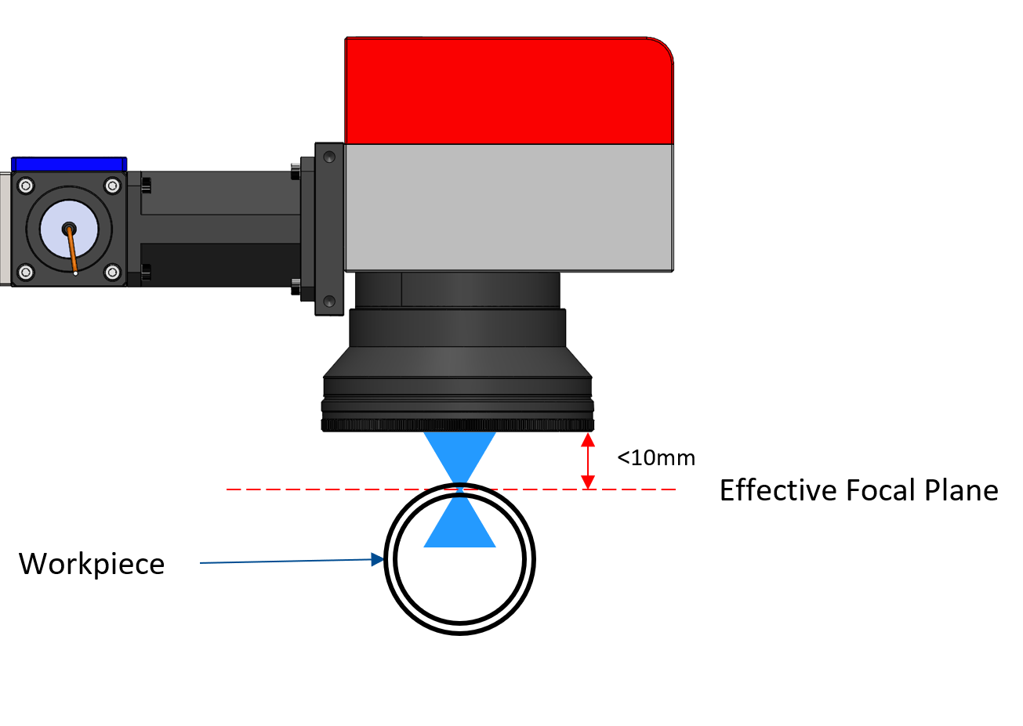
Special Research – Beam Manipulation
Shorten the “Rayleigh Length” and avoid thermal deformation due to volumetric absorption!
To avoid annoying issues with volumetric absorption, it is possible to use a highly convergent beam to achieve maximum laser energy “mostly” where the focal point of the is at.
Other “areas” (fluidic channels, tubing ID’s, etc.), that are in the beam path, remain in the de-focused zone and thermal effects are somewhat minimized.
This can be used on microfluidic parts that have channels or fluid paths on multiple levels or even in radial welding applications!

Slide 29
SUMMARY

Slide 30


Summary
TPLW technology is a promising alternative to the traditional “TTLW”
While it has some limitations due to its “nuances” (thermal effects, etc.), it also offers some distinct advantages, including the ability to penetrate deeper into certain materials as well as eliminate the need for any laser absorbing additives.
The properties of the laser beam, including its shape, size, angle of incidence, and intensity, can have a significant impact on the quality of the weld.

Slide 31
Summary
We will work with you completely from start to finish
Material selection and guidance
Joint design input
Both TTLW and TPLW welding technologies
Prototype tooling and welding services
Standalone and automated equipment
Vision inspection – Thermal and IR
Navigate the tricky realm of laser plastic welding!
How we can help you…

Slide 32
Thank you for your Attention!
Stay tuned for more education on Laser Plastic Welding…

